Slide 1
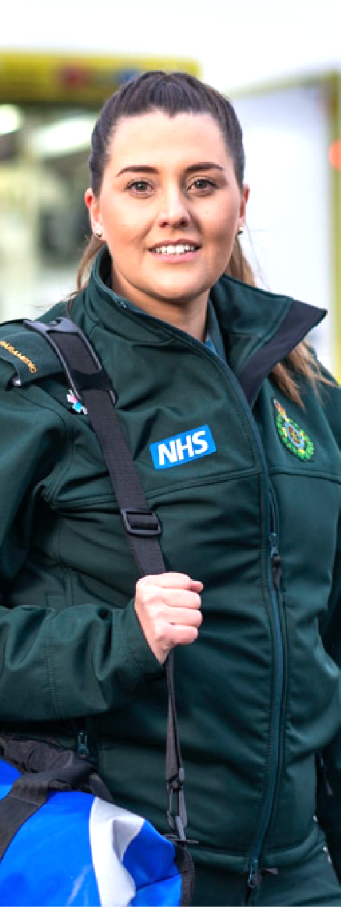
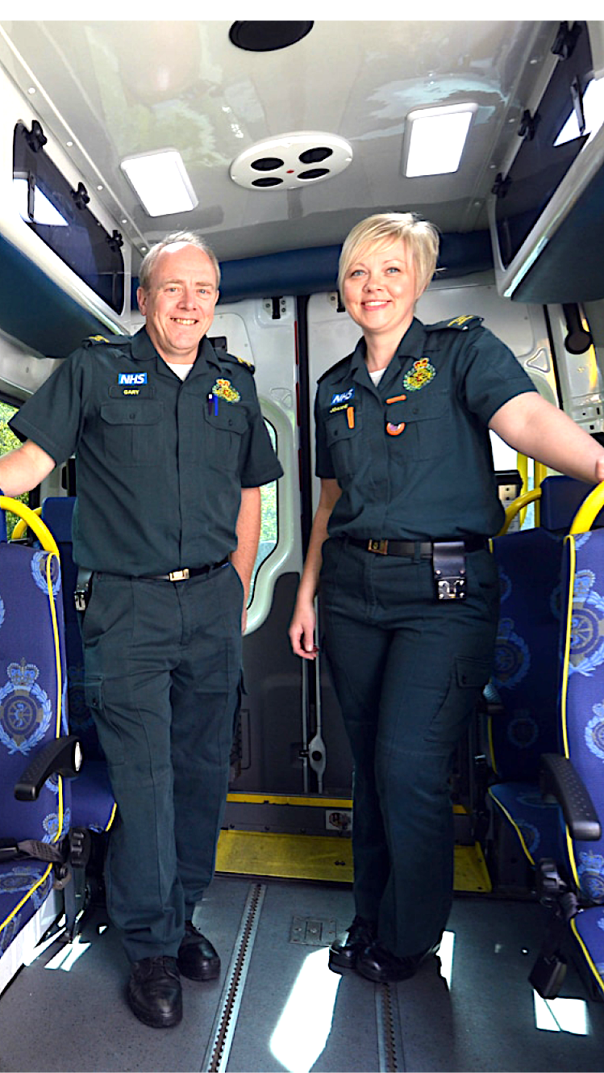
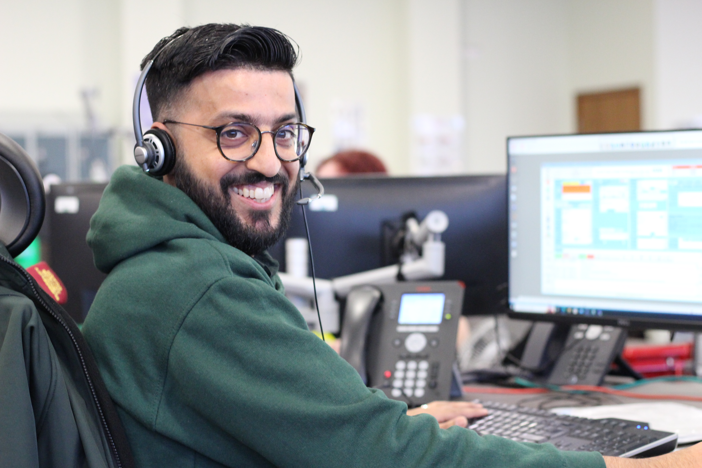

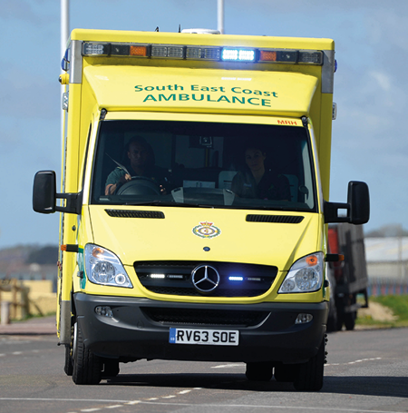
2022/23 Financial Report to the
Annual Members Meeting
Saba Sadiq, Chief Finance Officer

Slide 2

Finance
Emerging from the pandemic
At the start of 2022/23, the Trust was beginning to come out of two of the most challenging years in the history of the NHS.
The COVID-19 virus continued, and its prevalence presented operational challenges across the NHS.
During 2022/23, following the pandemic, the focus turned to restoring services to pre-pandemic priorities and financial arrangements.

Slide 3

Financial Framework
The pre-pandemic financial planning process was re-introduced.
The financial framework moved to local contracts under the National Tariff Payment System.
SECAmb had a fixed funding envelope that was revised and supplemented with additional funds for growth and excess inflation for fuel and energy.
COVID-19 funding was reduced by £10m.
There was a national requirement to find efficiencies. SECAmb’s target was £5.6m.
Notes:
Going into 2022/23 was going to be financially challenging.
The financial plan reflected
Reduced Covid funding
An efficiency requirement
Uncertainty about the prevalence and transmission of Covid-19

Slide 4
Income and Expenditure Account
Audited Accounts
The Trust had an agreed target of delivering a breakeven financial performance with Surrey Heartlands Integrated Care System (ICS).
SECAmb delivered an adjusted financial performance of £46k so slightly better than the agreed target of breakeven.
Efficiency improvements of £5.4m were delivered.
SECAmb made £32.3m of capital investments in infrastructure, digital, medical equipment and leased assets to support the delivery of high quality, safe patient care.

Slide 5
Our Auditor’s View
External Audit
Our external auditor is KPMG
The Auditor opinion confirms that the
financial statements:
Give a true and fair view of the financial position of the Trust; and
Have been prepared properly in accordance with the appropriate legislation and guidance; and
On securing economy, efficiency and effectiveness in the use of our resources, our auditor identified the main weakness arising from the CQC Well Led inspection.
Internal Audit
Our internal auditor is RSM
Overall, the internal auditor was able to provide partial assurance that there is a sound system of internal control, designed to meet the Trust’s objectives and that controls are being applied consistently.
More work has been performed on embedding risk processes across SECAmb since 2022/23.

Slide 6
Capital
2022/23 South East Coast Ambulance Service NHS FT Capital expenditure (£m)
Capital Spend | £000
Estates | 12,824
IT | 2,312
Fleet | 6,727
Clinical Operations | 819
Total Internally generated | 22,681
Right of use assets
Fleet | 8,496
Total Right of use assets | 776
Estates | 9,272
PDC Funding | 297
Total Capital Expenditure | 32,250
SECAmb delivered a Capital spend
of £32.3m for 2022/23
Key programmes, all of which support the delivery of high quality and safe patient care, included:
Estates £12.9m
Fleet £6.7m
IT £2.3m
SECAmb also leased assets which included:
Fleet £8.5m
Estate £0.8m
Notes:
In 2022/23 we were building a Medway Make Ready Centre which has our 999 and 111 functions so that’s where the majority of the £12.9m was spent on.
We improved our digital infrastructure so for example we bought ipads for our ambulance crews so that they can input patient information on the spot.
We bought new ambulances which needed to be fitted out with medical equipment so that we continue to provide high quality and safe patient care.
We also have leased assets which includes some ambulances and single response cars for our specialist paramedics.

Slide 7

Financial Plan 2023/24
Planning and Contracting – return to “normal” processes
SECAmb has a breakeven plan in line with national guidance
Efficiency target of £9m
Financial planning assumptions agreed across the Integrated Care System
Capital plan is £25.9m to support our infrastructure and the care we deliver to our patients
Delivery of the financial plan has challenges
  Workforce constraints
  Pressures on our services
  Inflationary pressures
  Efficiency target
Notes:
Looking forward to 2023/24
The planning and contracting process returned to normal
SECAmb had a breakeven plan in line with national guidance
We set ourselves an efficiency target of £9m which is a challenging target. Our frontline staff have been engaged in the process of developing ideas to help us, push towards achieving this target. Our people have suggested 177 efficiency ideas for us to take forward and I would like to take this opportunity to commend all of our People who have shown the commitment and energy to support SECAmb in developing efficiency ideas, many of which are now moving into the delivery phase.
Our capital plan is £25.9m. This capital investment supports how our frontline staff deliver care.
Delivering the 2023/24 financial plan is not without challenge. We have workforce constraints, there are pressures on our services and these pressures continue to grow, we have inflationary pressures and, as I have already, mentioned we must need our £9m efficiency target.

Slide 8
Receiving the Annual Report and Accounts
The Council of Governors and Members are asked to receive the 2022/23 Annual Report and Accounts
Annual Report & Accounts 2022-23 - NHS South East Coast Ambulance Service (secamb.nhs.uk)
Notes:
The 2022/23 Annual Report and Accounts can be found at the website link on the slide.
And finally, the Council of Governors and Members are asked to receive the 2022/23 Annual Report and Accounts.
Thank you.

Slide 9
Lead Governor’s Report
Leigh Westwood

Slide 10
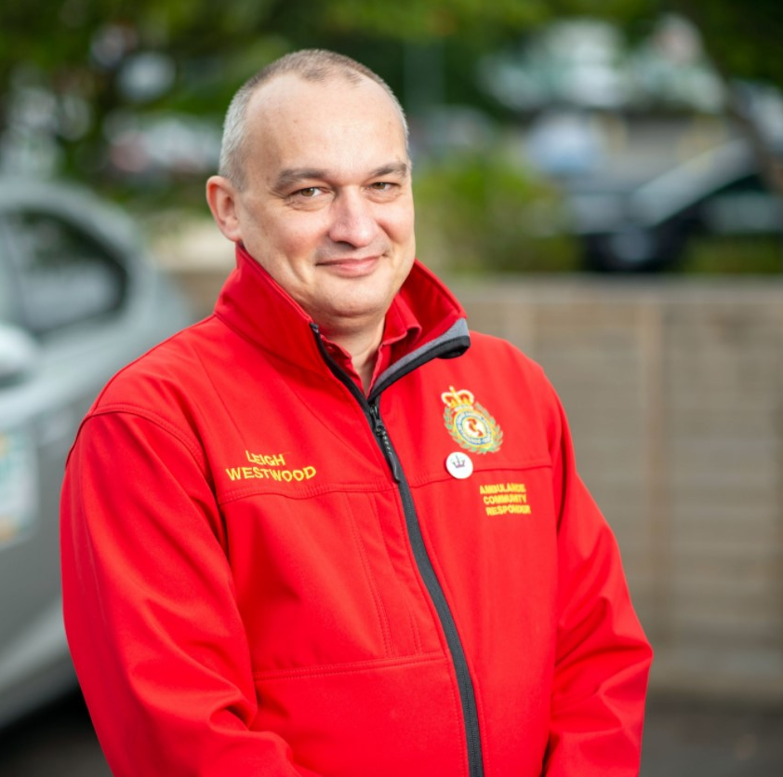
What are our duties?
The Council of Governors - a group of 18 volunteers including members of the public, staff, and people from key partner organisations - has two duties:
1.
To represent the interests of our Foundation Trust members and the wider public
2.
To hold the Non-Executive Directors (NEDs) to account for the performance of the Board
Before I begin, I would like to thank both our new Chief Executive, Simon Weldon and David Astley our Chair for their commitment and for always respecting and supporting the role of the Governors within the Trust.

Slide 11
Looking back at 2022/23
2022/23 saw many challenges:
The Council has been focussed throughout the year on helping ensure that the Trust was doing its best to support its staff and volunteers, while recognising that quite frequently the demand for its services was incredibly high.
Whilst staff recruitment and retention continues to be challenge, the Council adds its thanks to all our dedicated colleagues throughout the Trust and the incredible volunteers who have and continue to support the Trust.
As a volunteer Community First Responder myself, I see first-hand the compassion, kindness and effective care given to our patients, regardless of the challenges we may be facing in the background.
High demand on our services
New facilities, like our tenth Make Ready Centre at Banstead, being completed
Good progress made on our new multi-purpose centre in Medway, which will house both 999 and NHS 111 operations.

Slide 12
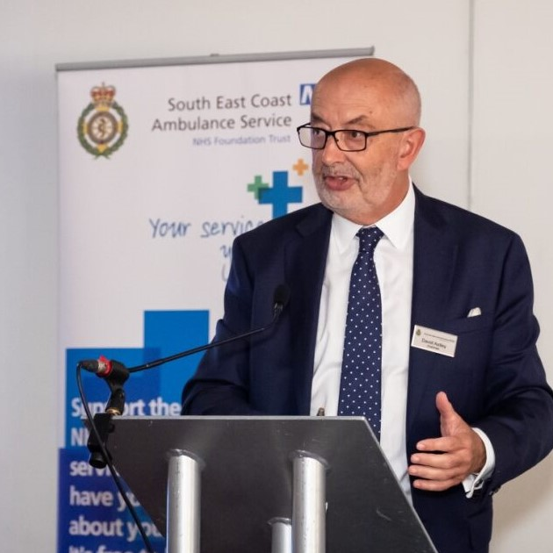
Looking back at 2022/23
Throughout the year, the Governors have continued to observe Board meetings and Board Committees, and this has provided the Council with the assurance that Board scrutiny and oversight has continued.
Foundation Trust membership engagement and recruitment as well as external events that had to be stopped over the past few years, has now been able to restart.
Communication via our membership newsletter, Membership Matters, has continued and although our membership numbers remain strong, we are consistently looking at ways to increase membership.
By doing so, we can listen to the public we serve and ensure that we continue to shape ourselves into a service with vision, direction, a known strategy, not just visible to our colleagues but also to the public.

Slide 13
Looking back at 2022/23
It is fair to say that for the Council as well as for the Board and Trust more widely, the focus has, quite rightly been on responding to changes in our CQC rating, following planned and unannounced inspections.
However, the Council has continued to seek improvements in other areas of the Trust where reasonable during the year.
We do this through questions submitted between formal meetings as well as by holding the Non-Executive Directors (NEDs) to account at our Council meetings.
Areas of focus for Council have included:
Operational performance in 999 and 111: how well are we serving our patients
Assurance around items highlighted in NED committee reports
The work of the Councils committees
The plans for the Trust’s Improvement Journey
The launch of the Volunteer Emergency Responder initiative
IT resilience
Reviewing the annual audit report via presentation from KPMG

Slide 14
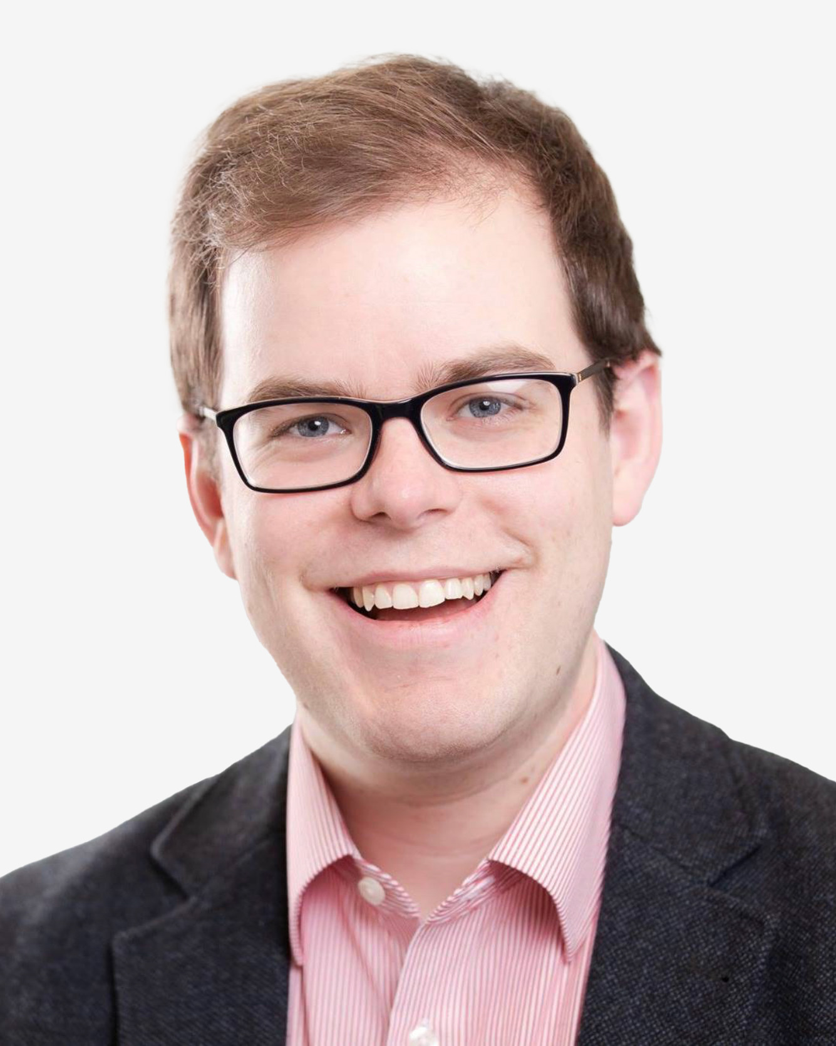
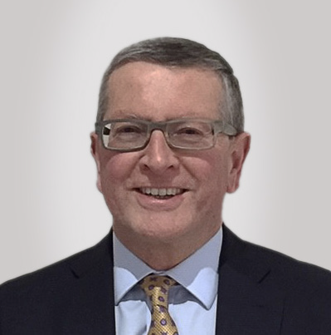
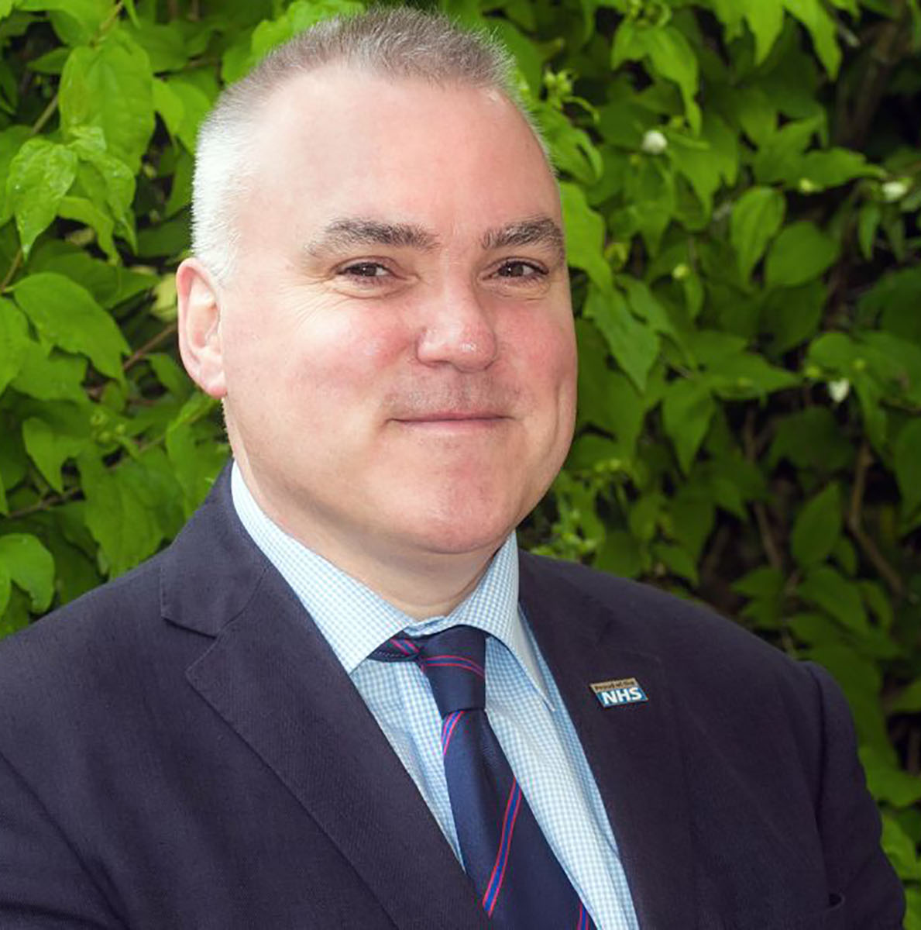
Looking back at 2022/23
In terms of our statutory powers:
Non-Executive Director (NED) remuneration has remained static during the year.
Max Puller, recruited by the Nominations Committee of the Council, joined SECAmb in January 2023
The Council has made the following NED appointments and reappointments this year:
The Council approved a second term of office for Howard Goodbourn and Professor Tom Quinn

Slide 15

Council elections
Council elections were held this year with a good turnout in nominations and votes.
Thanks to all members who took part and to those Governors who either re-elected or have joined us in the last year.
You can read more on the Public, Staff and Appointed Governors currently serving in Membership Matters.
If you think you can you give time, energy and thought to helping us be the best we can be, for patients and staff and are passionate about the NHS please consider standing in our Council of Governor elections.
As a Trust member you can stand as a Governor or vote for a Governor to represent you.

Slide 16
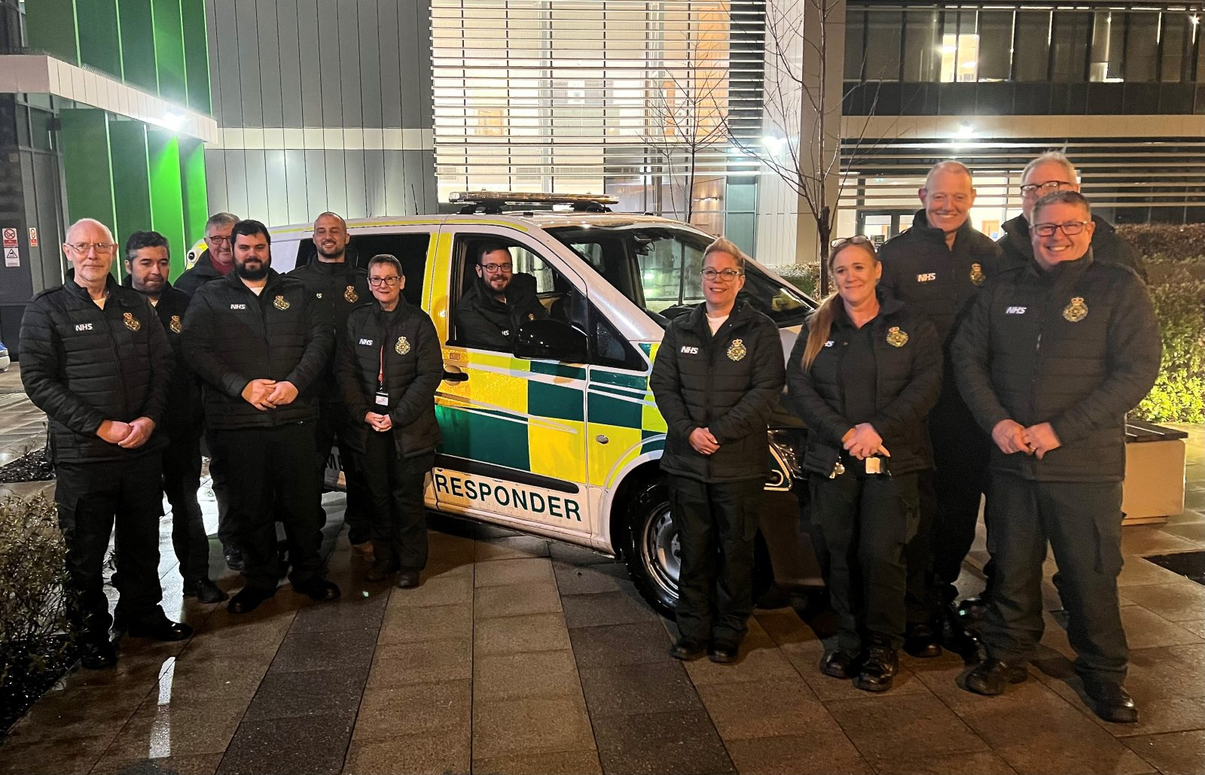
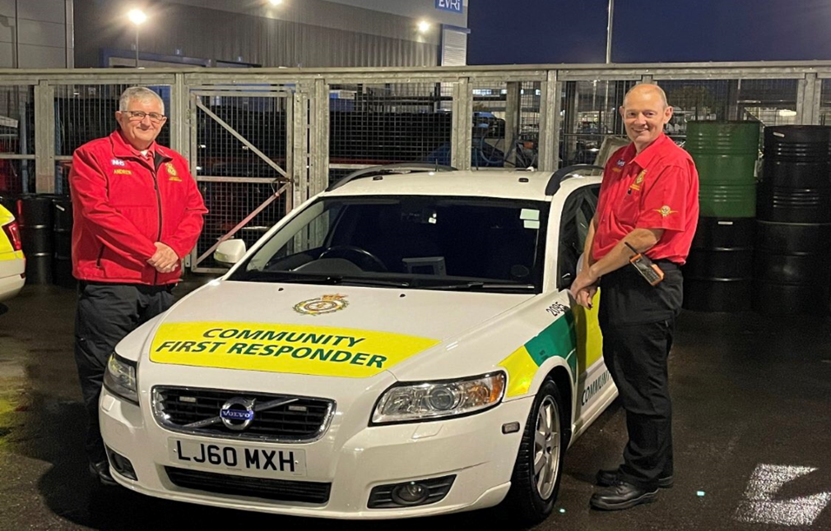
In summary
Finally, I must express again on behalf of my Governor colleagues our thanks, admiration and utmost respect for everyone working for or within SECAmb and across the wider health and social care system during the past year.
Governors must continue to hold the Non-Executive Directors to account for the performance of the Board and I thank them for the open working relationship the Governors continue to experience.
As a Council, we will continue to ensure that we discharge our duties to the best of our abilities, to continue serving those we represent.

Slide 17
Looking back at 2022/23
and to new challenges ahead
Simon Weldon, Chief Executive Officer

Slide 18
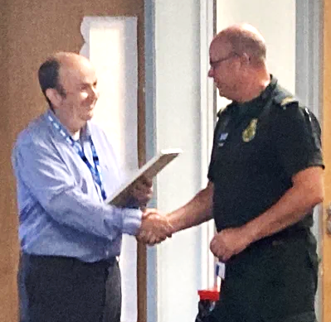


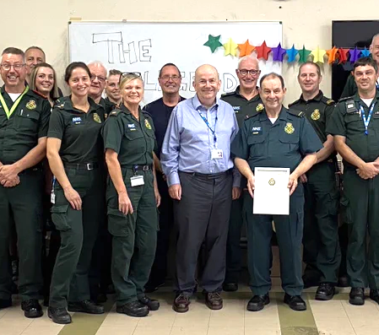
A year of continuing challenge
both for the NHS as a whole and for SECAmb…
Looking back at 2022/23, it was undoubtedly a challenging year - I will pick out just a couple of areas to highlight before I focus on our future.
I was extremely pleased to join SECAmb as Chief Executive in April 2023 and have been made to feel very welcome so far.
I have been extremely impressed with the compassionate care and professionalism I have witnessed through spending time with colleagues on the road, in our control rooms and in our support teams.

Slide 19




Looking back at 2022/23
999 & 111 performance
We continued to see increases in the number of 999 and 111 calls compared to the previous year and also in the acuity of the patients contacting us
Coupled with challenges in ensuring we had sufficient staff available to meet the demand, this meant that, at times, some patients waited longer than we would like
Although we performed well compared to our ambulance colleagues nationally, we were not able to consistently meet the national targets for both 999 and 111
We recognised that, whilst trying to deliver performance improvements, we also needed to remain focussed on keeping our patients safe.
266 patients survived after suffering a cardiac arrest
Over 2.2 million calls taken between 999 and111 services
229,000 patients treated at home without requiring transport to hospital
70,000 patients referred to another service, keeping ambulances for those who need them most

Slide 20
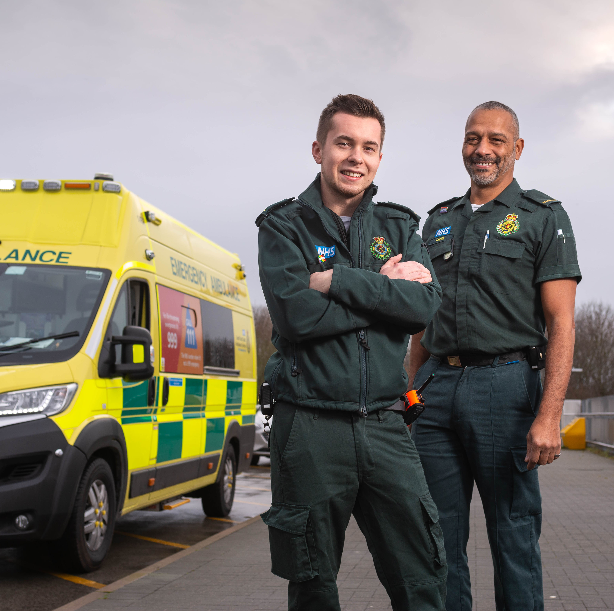
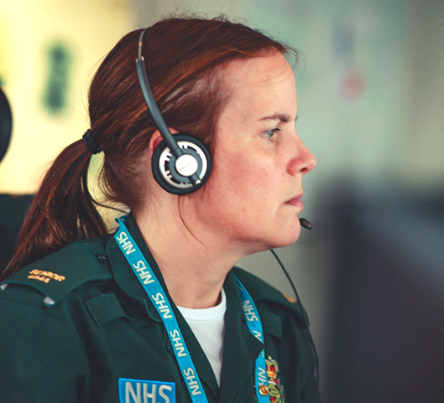
Looking back at 2022/23
Working with the CQC
In August 2022, the Trust underwent a follow-up inspection by the CQC that reviewed the full range of our urgent and emergency care services, including resilience and specialist operations functions.
When the findings were published in October 2022, the Trust’s overall rating was changed to ‘Requires Improvement’ - the individual rating for ‘Caring’ remained rated as ‘Good’
We are committed to contiuing to make the improvements we know we need to make.

Slide 21

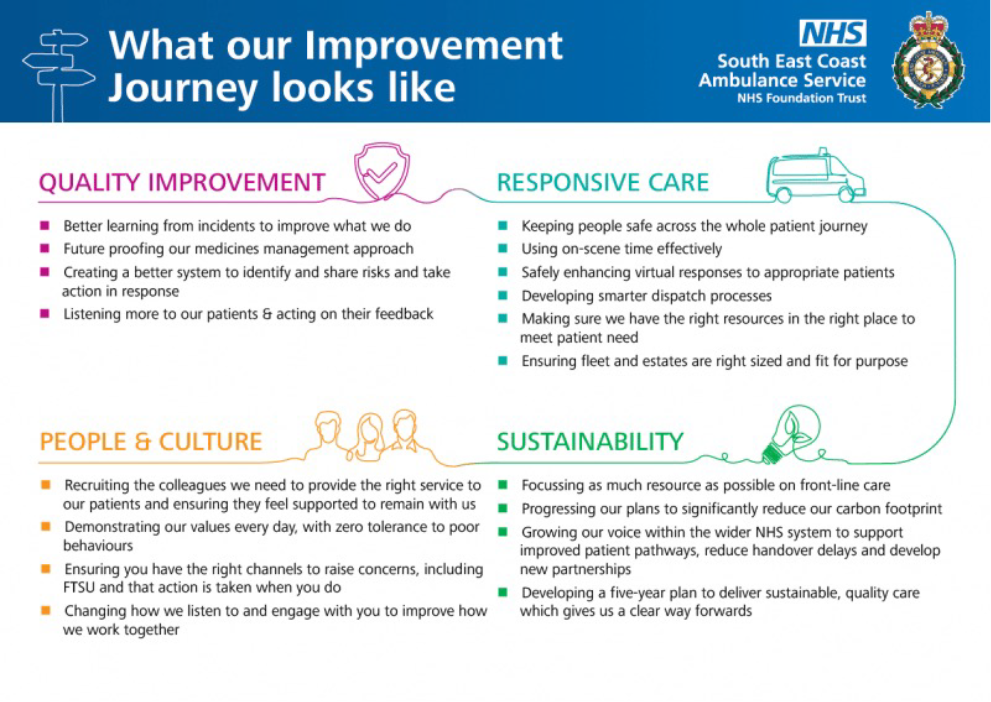
Looking back at 2022/23
Our Improvement Journey
During the year, we continued to focus hard on our Improvement Journey framework, developed in early 2022/23 in response to feedback from the CQC, NHS Staff Survey, and NHS England.
It included four key programmes – People & Culture, Responsive Care, Quality and Sustainability.
Good progress has been made in many areas, but we recognise that there is much more we need to do, including the delivery of our new People & Culture Strategy
What our improvement journey looks like…

Slide 22






Looking forwards
Ambitious but realistic…
I now want to look forward and, having recently completed 100 days in post as Chief Executive, I feel able to share my seven priorities for the Trust
These have not been developed randomly – they are based on what I’ve heard and seen from our people and our partners
They will undoubtedly take time to deliver - the change that we are embarked on takes several years to deliver
And while it is essential to be ambitious in our aspirations, we also must be realistic about delivering progress that is sustainable.

Slide 23

1.
Creating our future strategy
Looking forwards…
Our future hinges on developing a clear, clinically led trust-wide strategy. As patient and clinical care is our business, this means we won’t have a separate clinical strategy - our Trust strategy will be 100% clinically driven.
After extensive engagement, the development of our new Strategy started in earnest in July 2023
We are firmly committed to this being ‘co-developed’ by our people and our partners.
The new strategy will be built on a number of key components – innovative models of care, making the best use of technology to drive improvements and ensuring everything we do is sustainable in terms of environmental impact and resources.
We are working towards the Strategy being finalised during late 2023 and presented to the Trust Board in early 2024 for final sign off

Slide 24
Looking forwards…
2.
Changing the culture
We need to change the way people feel about joining, working and staying with SECAmb
We need to give our people ‘meaningful autonomy’ to develop, innovate and lead
We’ve already started by focussing on our key operational managers who are closest to our people and who have an important role in making sustainable change

Slide 25
Looking forwards…
3.
Developing
our leaders
We need to properly support our leaders at all levels, starting with our senior leaders
We need to ensure they are supported and developed
We also need to make sure they are empowered to lead their teams

Slide 26

Looking forwards…
4.
Improving how
we communicate & engage
We need to tell our stories more fully in a way that connects and resonates with our people and celebrate our successes
We need to ensure our people have opportunities to be as engaged as they wish to be and that we are constantly listening and acting on their feedback

Slide 27
Looking forwards…
5.
Simplifying how we do business
We need to simplify and clarify the way in which business gets done within SECAmb
We need to remove unnecessary bureaucracy and ensure the systems we have in place are efficient and effective

Slide 28

Looking forwards…
6.
Set up to deliver
We need to ensure that we are structured in the right way to enable us to deliver our Strategy
Like many organisations, structures in SECAmb have evolved over time but this doesn’t always mean it is helping us to move forwards

Slide 29

Looking forwards…
7.
Getting the
HR basics right
We need to make sure that we make it as easy as possible for people to join SECAmb and that they feel well supported when they start with us
We also need to make sure that our people, including our managers, are well supported in their day to day working lives and that our key policies are up to date, and used consistently
When things don’t go well, we need to get better at working things through together and learning for the future

Slide 30
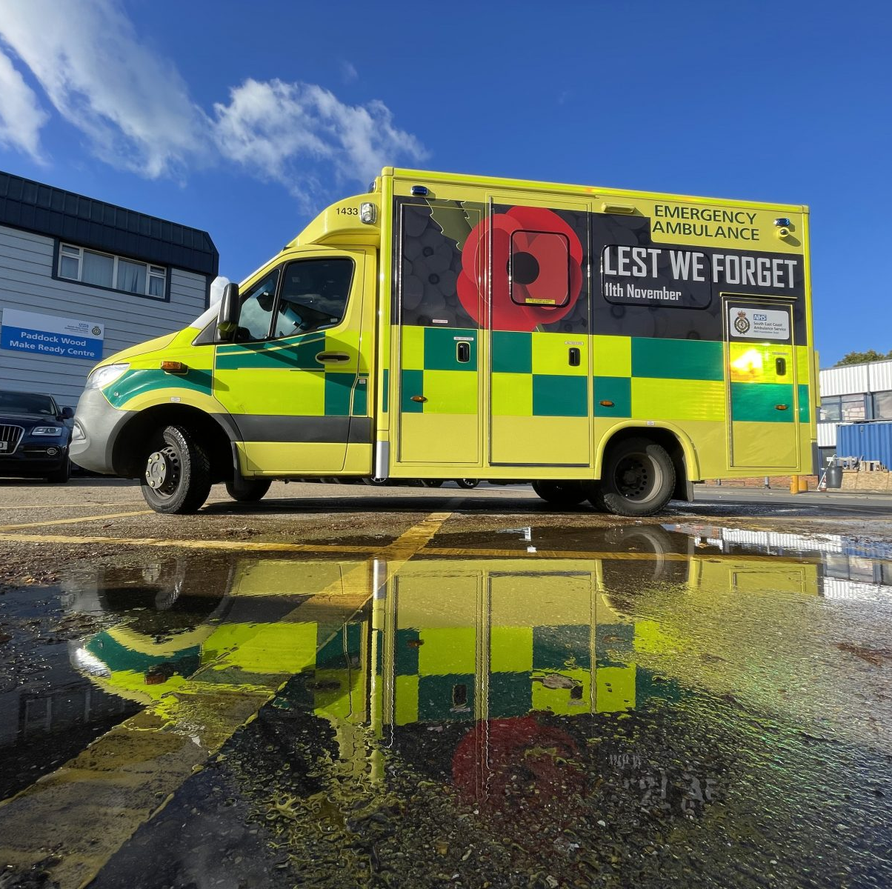

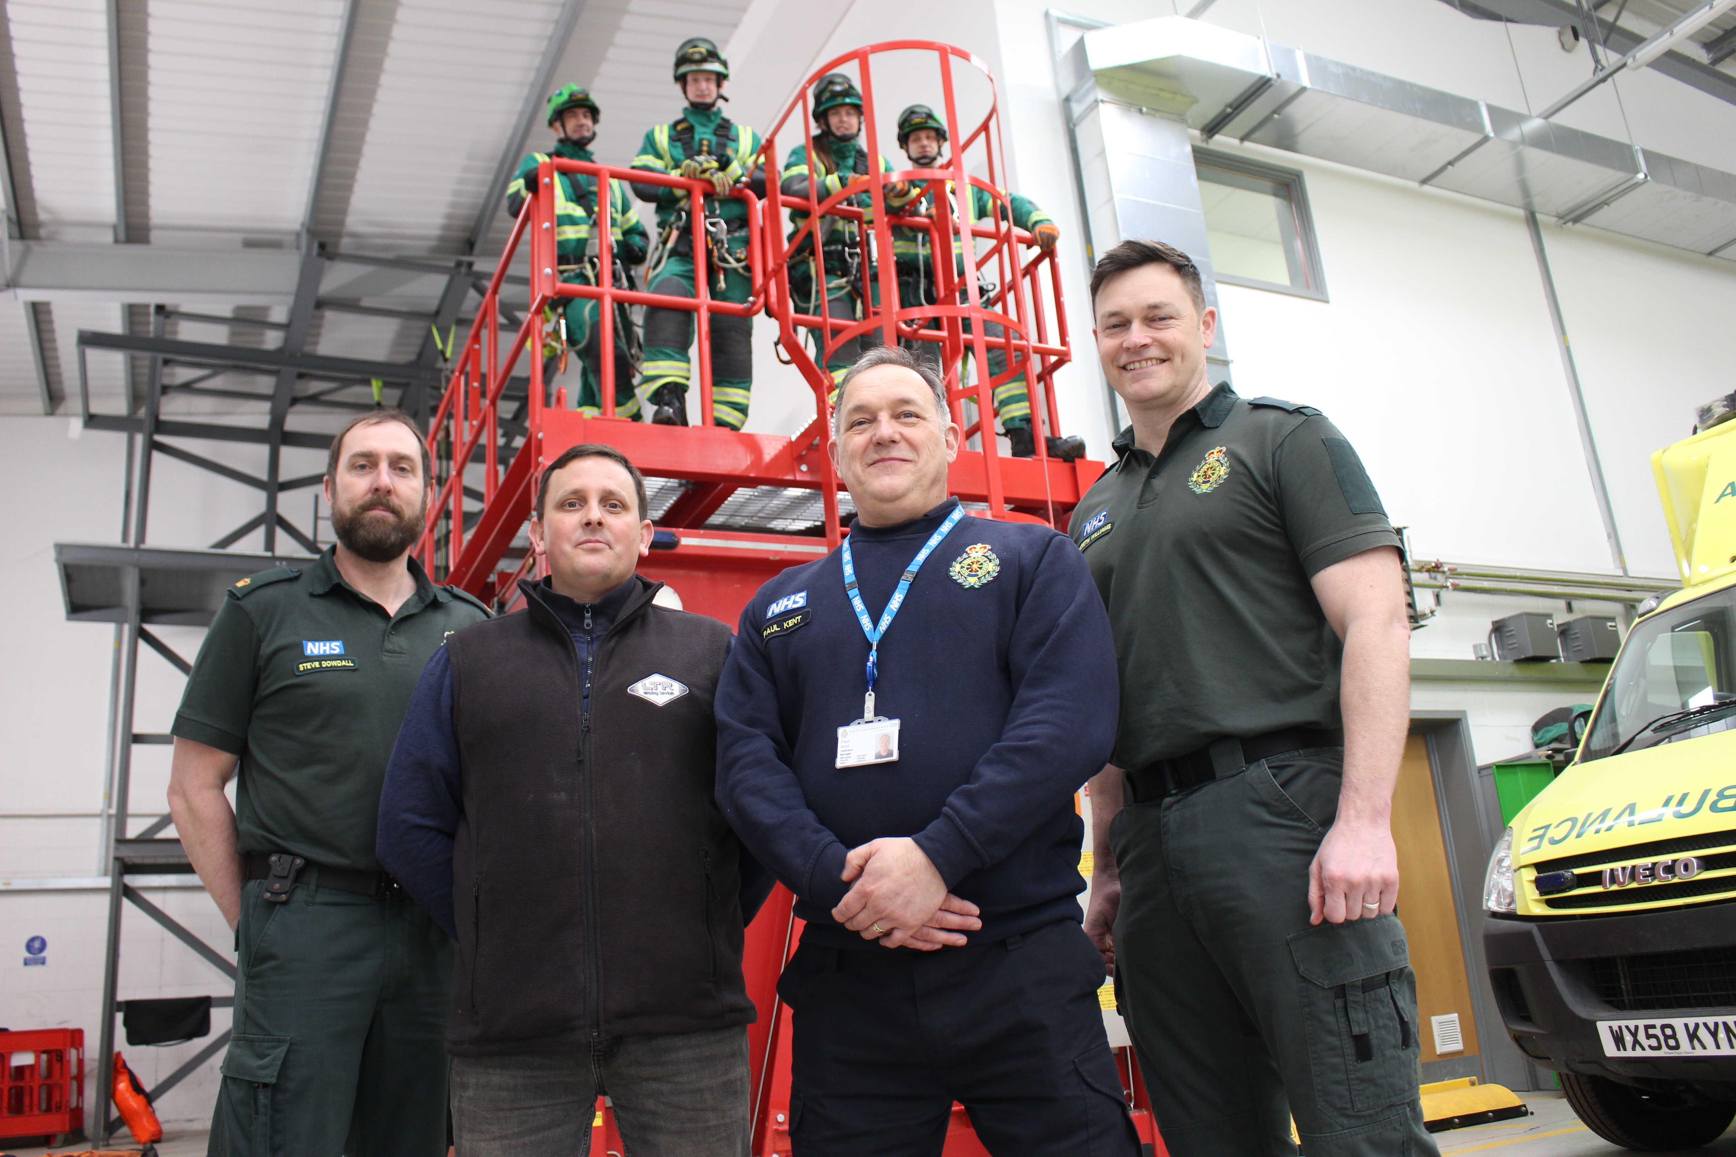
In Summary
2023/24 is an important year for SECAmb
We need to ensure we are fully focussed on our priorities, which will mean we are able to properly deliver our evolving Strategy
It's vital that we build confidence in our colleagues that things in SECAmb are different and will continue to improve

Slide 31
SECAmb Strategy Programme Update
14 September 2023

Slide 32
Our Vision
To create an ambitious, innovative long-term strategy that champions sustainable high-quality, equitable care for our patients, enhances the experience of our people, supports our partners, and protects our environment.
Our Approach
By valuing diverse insights, we are co-designing a strategy that is internally driven, and clinically led, ensuring a positive impact on our staff, patients, and partners.

Slide 33
The Need for a New Strategy
Diverse Patient Needs: Our patients range from social to critical care requirements.
Inadequacies of Current Model: The current one-size-fits-all, time-driven approach is not effective.
Tailored Responses: Patients require a differentiated approach — the right resource, at the right time.
Strengthened Integration: Imperative for closer working with primary and community care.
Empowered Decision-Making: Leveraging data-driven intelligence, technological advancements, and diverse clinical insights.

Slide 34
The “Wicked” Questions
What is our vision, purpose and role in the broader health system?
What does our service model need to look like to fulfil our purpose?
How do we engage, retain, and develop our workforce to deliver the strategy?
How do we harness technology, data, and innovation to transform our services?
What partnerships, financial resources and political alignment do we need to successfully execute our strategy?
How do we reduce health inequalities, and enhance environmental sustainability?

Slide 35



Journey Ahead
Frame
Diagnose
Forecast
Generate Strategic Options
Evaluate
Implement
Transform

Slide 36
Journey Ahead
Frame
Diagnose
Forecast
Generate Strategic Options Evaluate
Implement
Transform

Slide 37
Journey Ahead
Frame
Diagnose
Forecast
Generate Strategic Options Evaluate
Implement
Transform

Slide 38

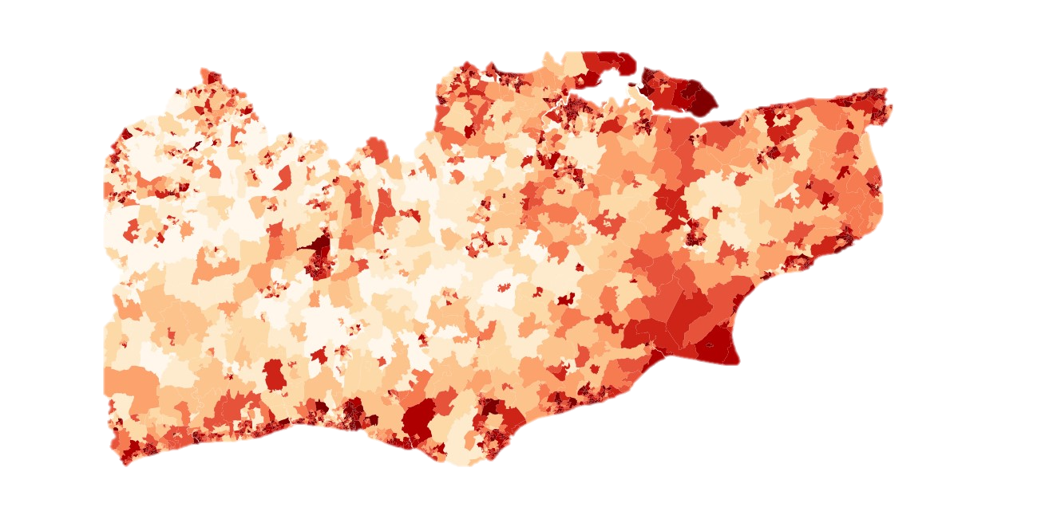
Where Are We Now?
Frame
Diagnose
Forecast
Who are
our patients?

Slide 39

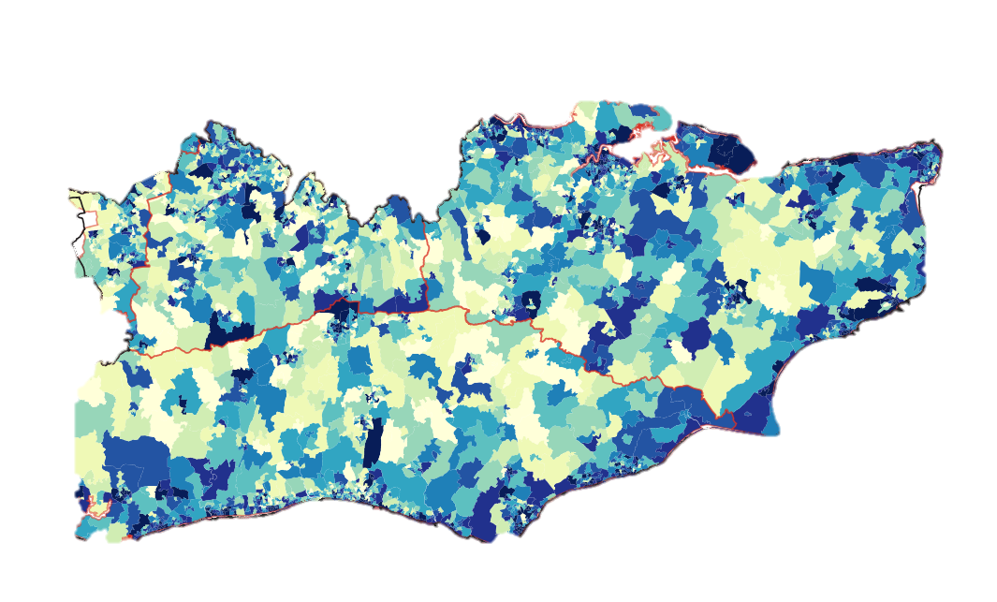
Where Are We Now?
Frame
Diagnose
Forecast
Who are
our patients?
Why do
they call us?

Slide 40

Where Are We Now?
Frame
Diagnose
Forecast
Who are
our patients?
Why do
they call us?
How are we
responding
today?

Slide 41
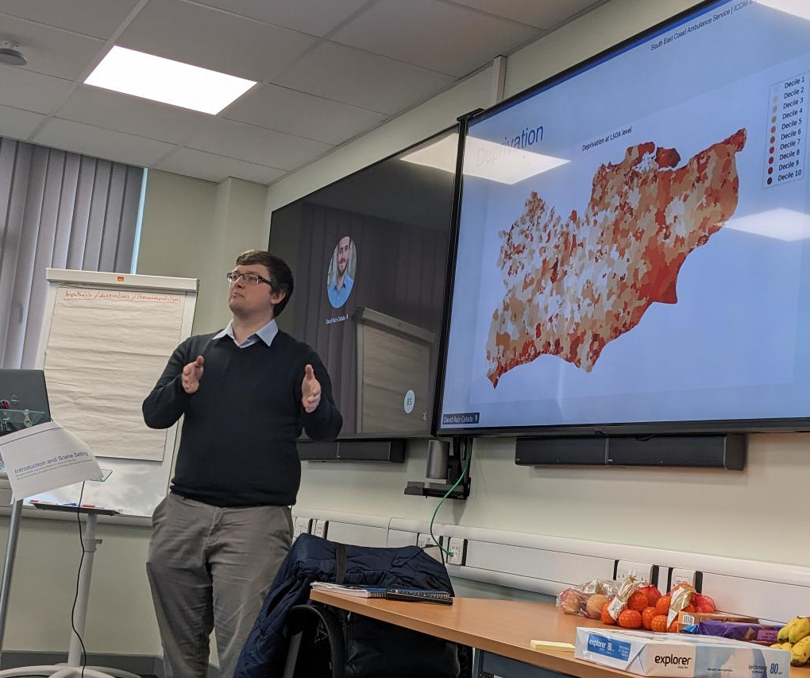
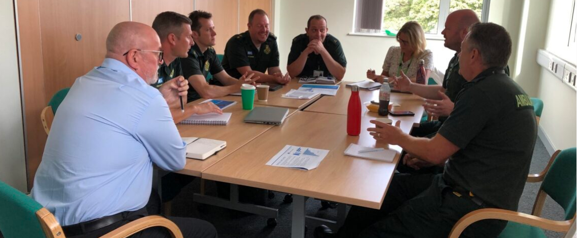
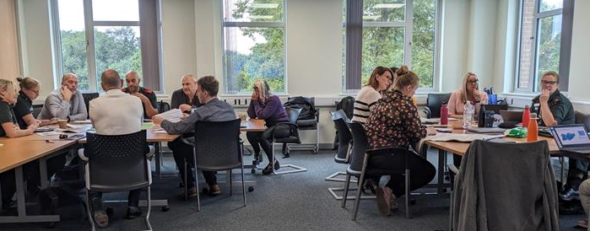
Where Are We Now?
Lived experience of our
clinicians delivering care
Frame
Diagnose
Forecast
Patients’ and commissioners’
needs and priorities
Data and evidence

Slide 42
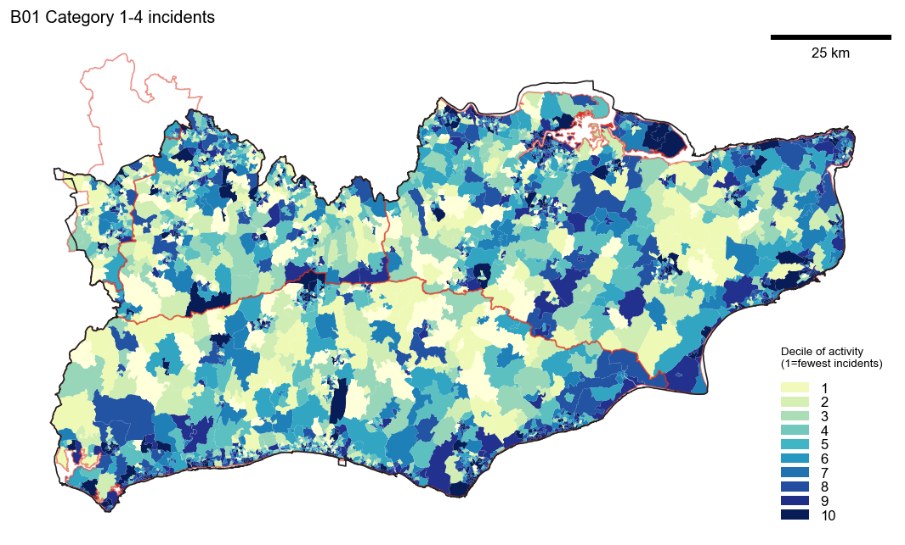

Slide 43
Did You Know:
54% of our demand is over 65s (20% of population)
20% of our incidents are cardiac issues (most common call)
Social problems, frailty and mental health make up 20% of our demand
1 in 10 hours on-scene are falls responses (5th most frequent call)
Last year we responded to 719,000 incidents from 433,000 unique patients
3% of patients generate 20% of our demand

Slide 44
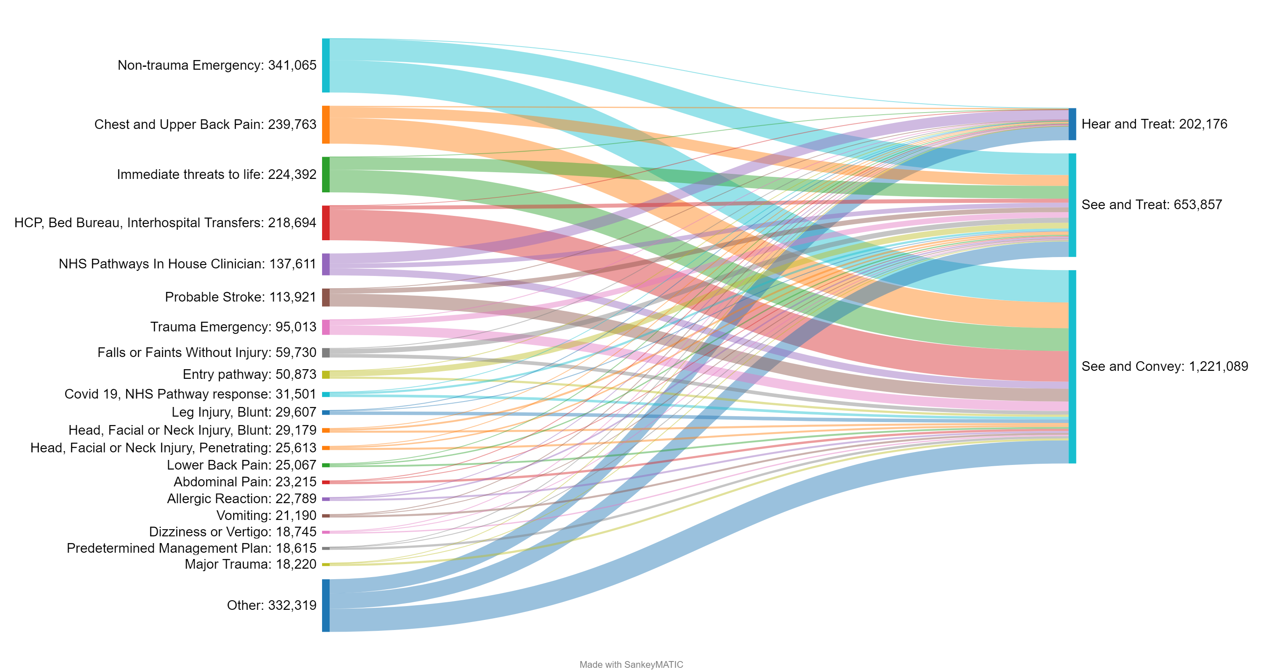

Slide 45
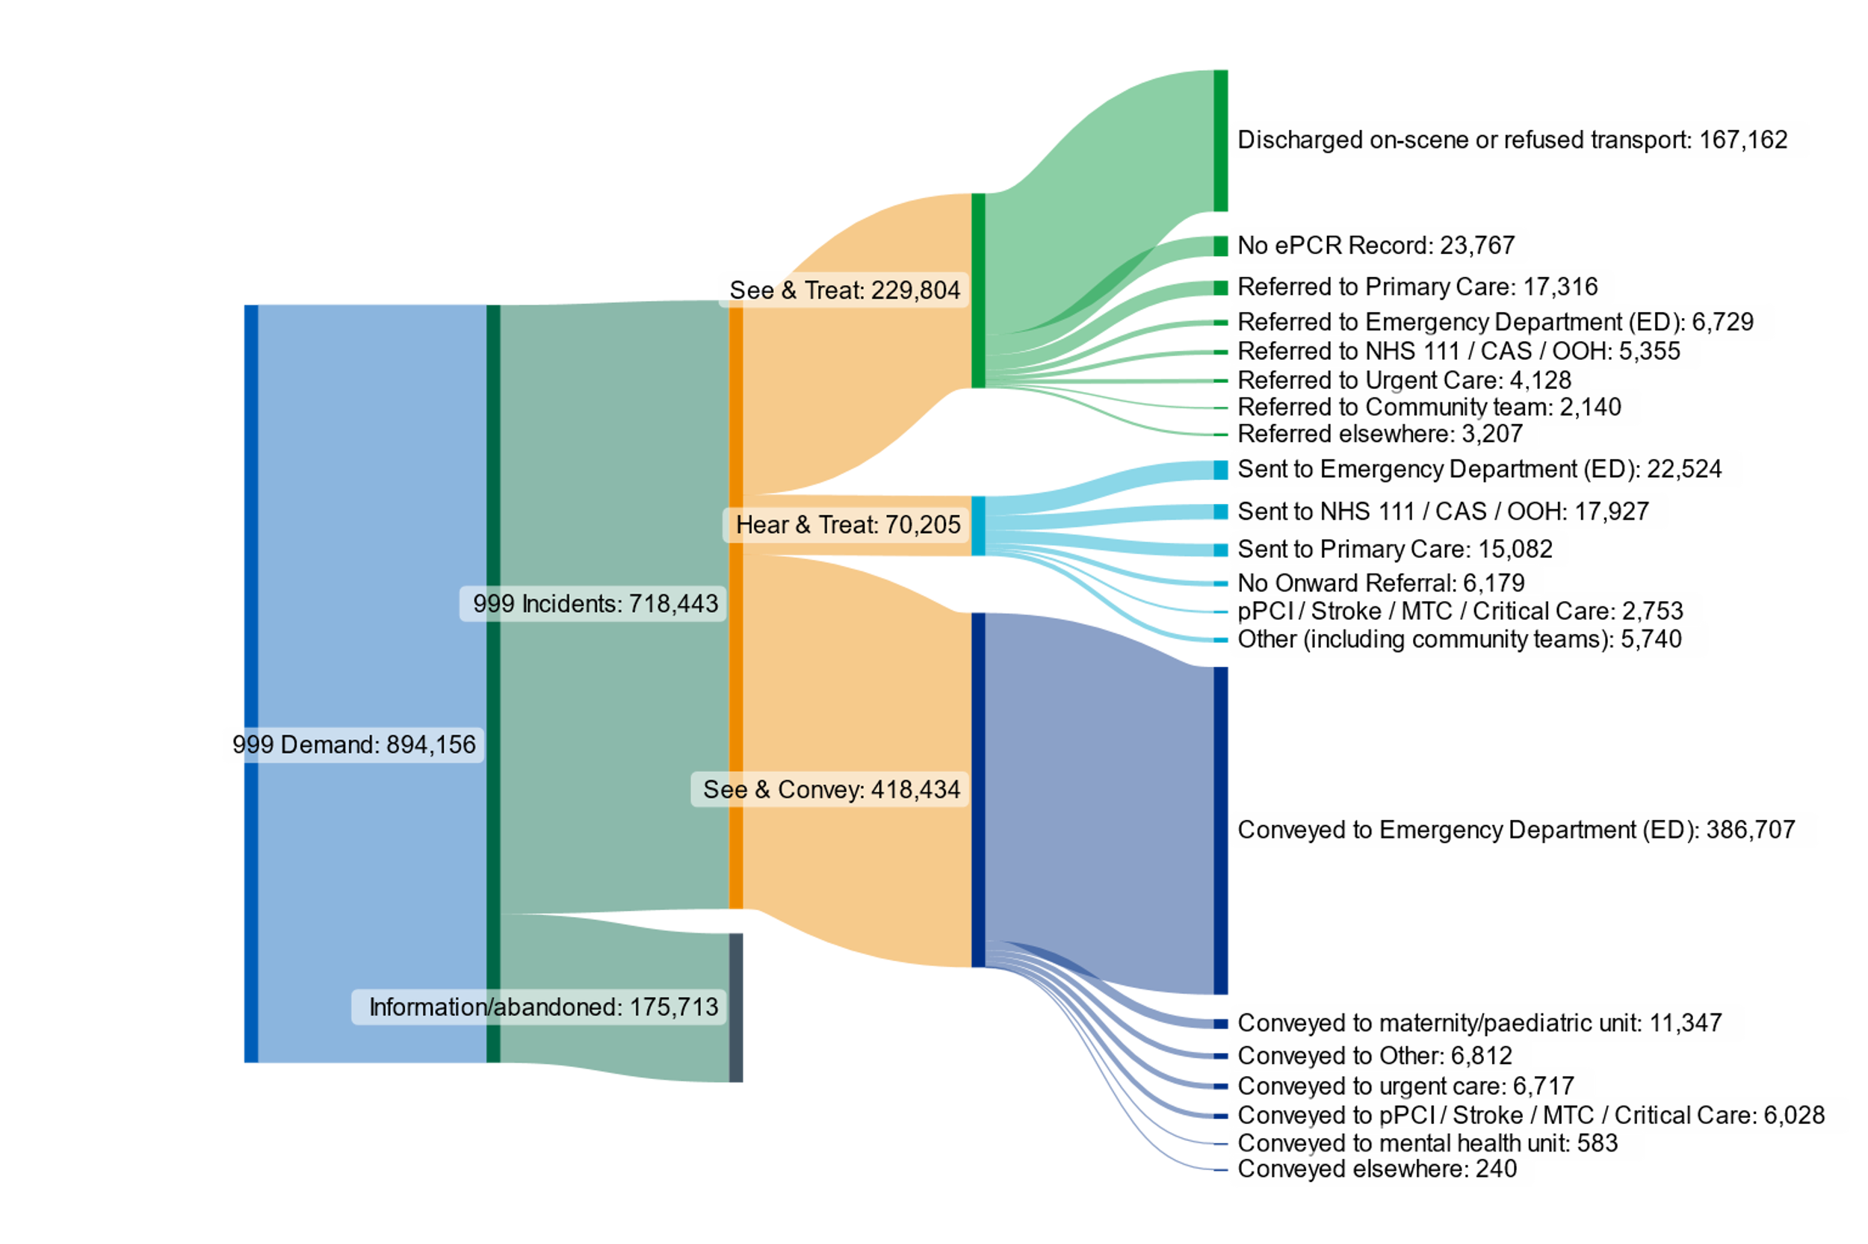

Slide 46


Strategy Programme Pillars
Our Patients
Integrated Care Delivery Model
Our People
Operationalisation
Our Partners
Culture & Values
Transformation & Change
Technology & Digital
Organisational Sustainability & Resilience
Programme Board
Governance
Trust Board | Council of Governors
Vision

Slide 47
Strategy Programme Pillars
Our Patients
Integrated Care Delivery Model
Our People
Operationalisation
Our Partners
Culture & Values
Transformation & Change
Technology & Digital
Organisational Sustainability & Resilience
Programme Board
Governance
Trust Board | Council of Governors
Vision

Slide 48
Strategy Programme Pillars
Our Patients
Integrated Care Delivery Model
Our People
Operationalisation
Our Partners
Culture & Values
Transformation & Change
Technology & Digital
Organisational Sustainability & Resilience
Programme Board
Governance
Trust Board | Council of Governors
Vision

Slide 49
Strategy Programme Pillars
Our Patients
Integrated Care Delivery Model
Our People
Operationalisation
Our Partners
Culture & Values
Transformation & Change
Technology & Digital
Organisational Sustainability & Resilience
Programme Board
Governance
Trust Board | Council of Governors
Vision

Slide 50
Strategy Programme Pillars
Our Patients
Communications & Engagement
Integrated Care Delivery Model
Data-Driven Decision Making
Our People
Operationalisation
Our Partners
Clinical Quality
Culture & Values
Transformation & Change
Technology & Digital
Organisational Sustainability & Resilience
Programme Board
Governance
Trust Board | Council of Governors
Vision

Slide 51
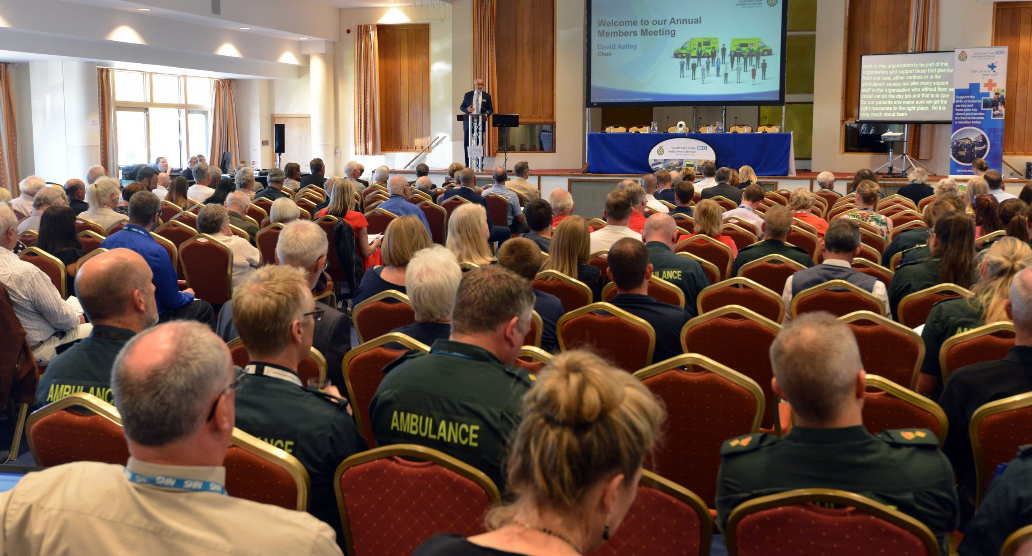
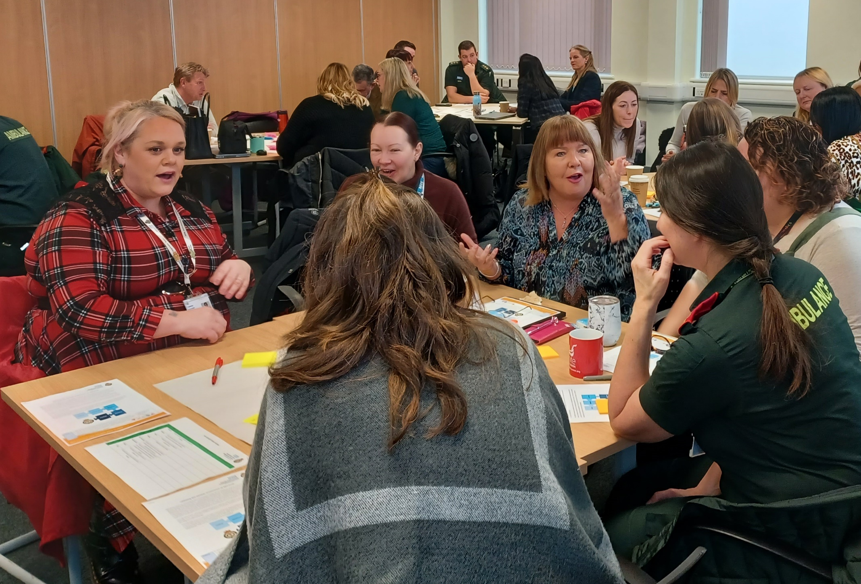
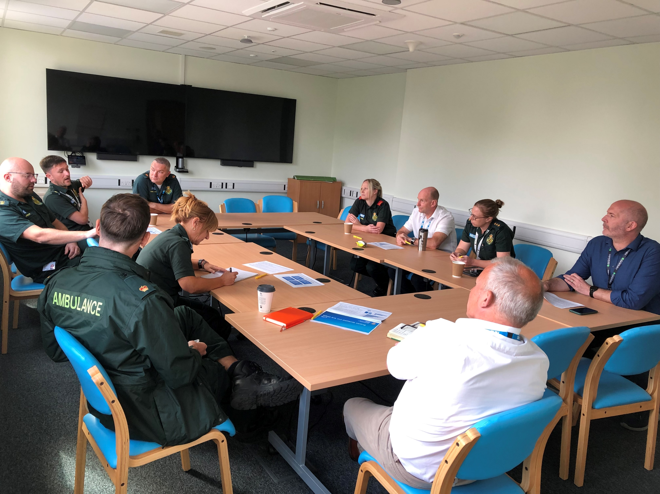
Your voice matters
We want your help to shape the future of our Trust
Your insights and feedback will drive us closer to our shared goals
Please visit our Strategy stand to find out more about the programme and have your say

